Slide 1
UniPubSub – Mobile Computing App Development Project Sandesh Pardeshi ssp9237@rit.edu Koustubh Kulkarni krk9372@rit.edu
Department of Computer Science
Rochester Institute of Technology, Rochester, NY

Slide 2
Motivation
Providing a dedicated platform for university students to share information (Buy/Sell items, Books, Events, Courses)
Inspired from the concept of Craigslist
Understanding and using Amazon Simple Notification Service
Implementing pub-sub architecture to achieve our goals

Slide 3
Current Work
Craigslist – Online website and mobile app
Online forums for students such as Edulix
No exclusive app for university students is present

Slide 4
Goals
Provide information exchange platform exclusively for students of various universities
Equip students to –
Create new topics
Search through existing topics
Publish information to specific topics
Subscribe to receive information in a specific topic
Receive email notifications
Provide access to university and category specific topics
Make use of Amazon SNS, pub-sub architecture and Android App Development

Slide 5
Design and Implementation Considerations
Implementation of Pub-Sub architecture
Decoupled in time, space and synchronization
Access to published information anywhere, anytime
Improved scalability as compared with traditional client-server architecture

Slide 6
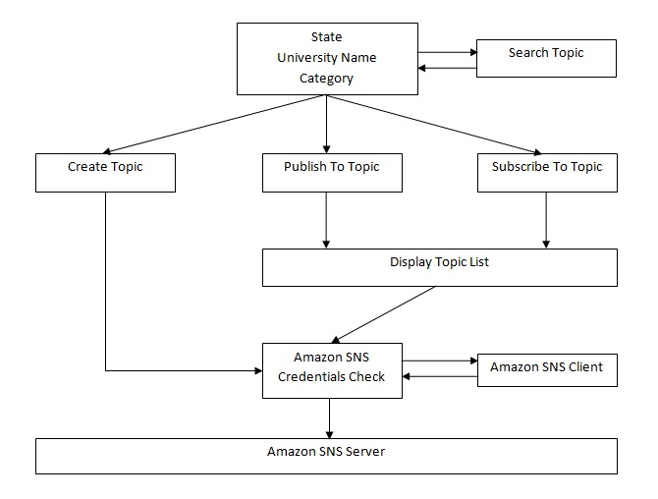
Architecture

Slide 7
Current Progress
Ability to create new topics
Search through existing topics
Publish information into certain topic
Subscribe to specific topics
Receive email notifications when information is published
Listing states and universities in those states

Slide 8
Analysis
Implementing pub-sub architecture by making efficient use of Amazon Simple Notification Service
Managed files to populate state, university and category lists
Modular architecture to reuse the implemented functionality
Efficient use of Java classes and Android API for providing university and category specific topics and performing search

Slide 9
Future Work
Improving app security by adding spam filters
Displaying published information on mobile devices and allowing to insert images in information publishing
Provide personalized usage of UniPubSub (Student Account Management)
Implement permissions for publishers and subscribers to restrict their access to all topics, if required.
Support for other platforms such as iOS, Windows.

Slide 10
References
Amazon Simple Notification Service
http://aws.amazon.com/sns/
Craigslist Mobile App
http://www.craigslist.org/
Android App Development
http://developer.android.com/develop/index.html
Stack Overflow
http://stackoverflow.com/

